Slide 1
Active House
Trenton Irwin

Slide 2
Introduction
My Active House project is a complete home monitoring system.
The idea is that you would have one Sensor Hub in each room of your home to collect data.
You would have one Raspberry Pi based base station which all of the sensor hubs send their data wirelessly to via the Xbee wireless modules I have installed in all devices.
The base station then sends the received sensor data to the web service which adds to to the database for use in my app.
Raspberry Pi based base station with an Xbee wireless antenna connected to it.
Arduino based sensor hub which includes the following:
Xbee Wireless Antenna
Light Sensor
Gas Sensor
Current Sensor
Water Flow Sensor
Temperature Sensor
Humidity Sensor
Remote Controllable Light
Buzzer

Slide 3
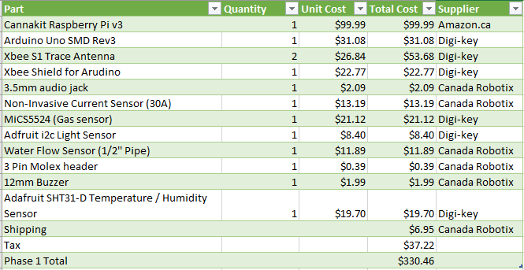
Budget

Slide 4
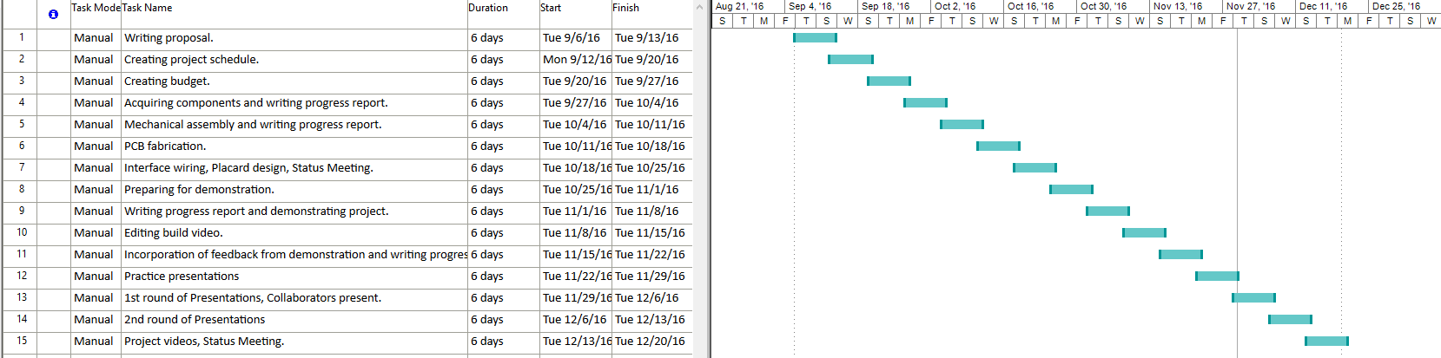
Project Schedule

Slide 5
Knowledge Used From Other Classes
Electronic Devices and Circuits – Soldering experience
Database with Java – Setting up database
Electronic Circuits – Voltage Divider calculations
Technical Workplace Writing – Creating write-ups and technical drawings
Software Engineering – Creating project schedules
Internet Programming – Writing web service

Slide 6
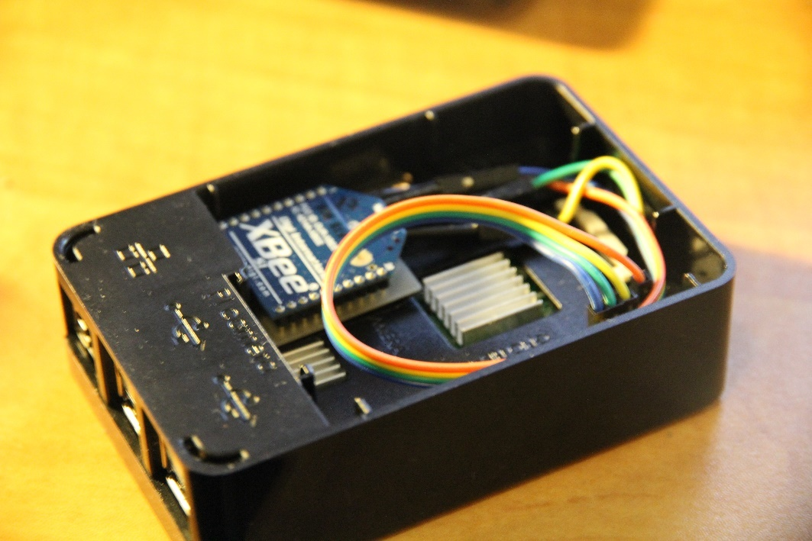
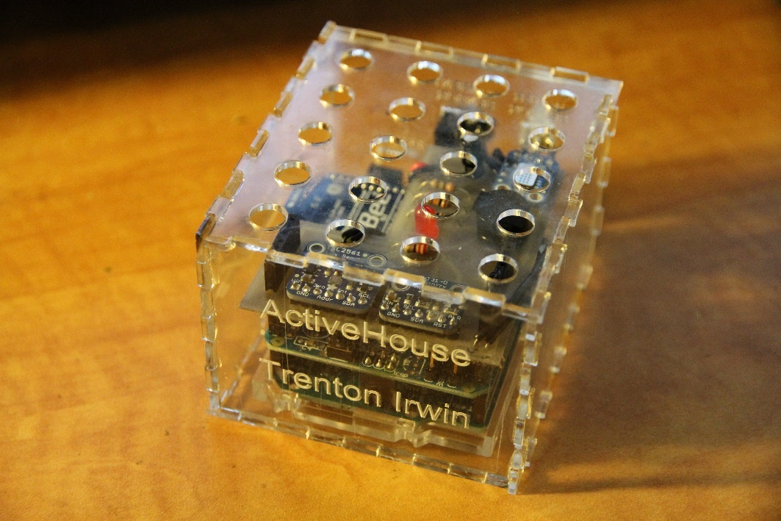
Hardware
Base Station
Raspberry Pi 3 with Xbee Wireless module
Sensor Hub
Arduino Uno with Xbee Wireless Antenna, Light Sensor, Gas Sensor, Current Sensor, Water Flow Sensor, Temperature Sensor, Humidity Sensor, Remote Controllable Light, and Buzzer

Slide 7
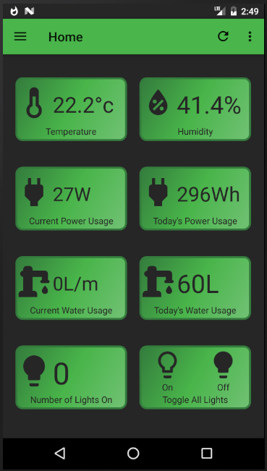
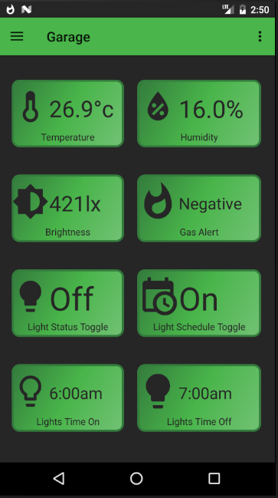
Mobile Android Application
The ActiveHouse Android app is used to view all of the sensor data from the

Slide 8
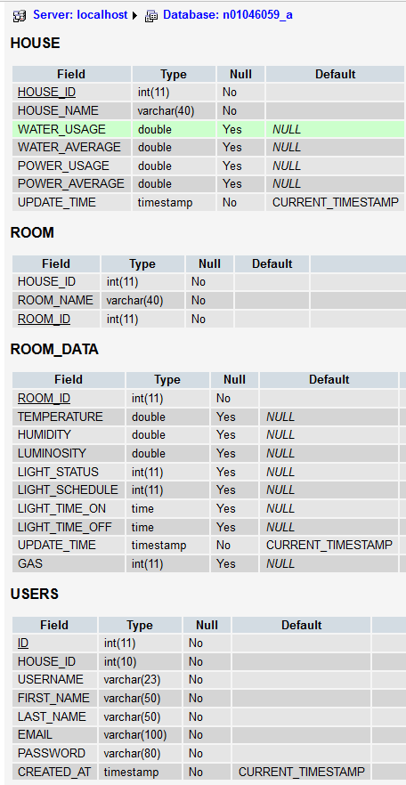
Web Interface / Database
I am using a MySQL database hosted on Munro to store all of my sensor data
The web service is written in PHP and is used to communicate with both the mobile app and the Raspberry Pi base stations to send and receive data from the database.

Slide 9
Conclusion
I consider my project to be a success because it is fully functional according to the original plan.
It does represent a hole in the market for home monitoring devices, most of which don’t usually include all of the sensors I did for water and electricity monitoring.
Unfortunately, to take the ActiveHouse project to market I would need to significantly reduce the build costs and move if off of Raspberry Pi and Arduino to cheaper micro controllers which would probably require a complete rewrite of the system.

